Slide 1
Power BI
From Zero to Hero
2022 series of talks & presentations
in preparation for PL-300 (old DA-100)

Slide 2
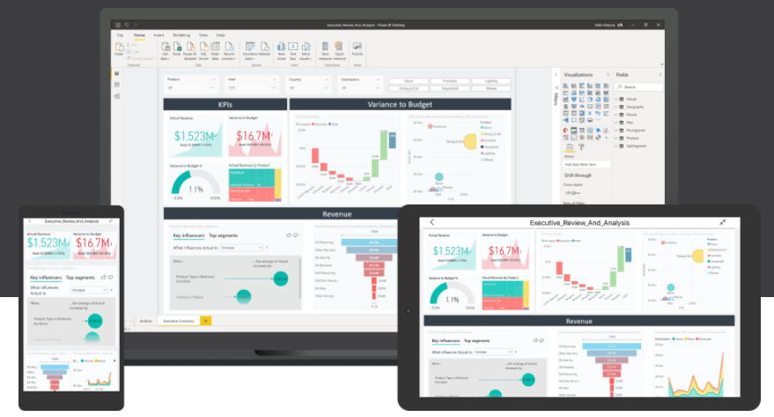

Power BI
preparation for PL-300 (old DA-100) online training course

Slide 3
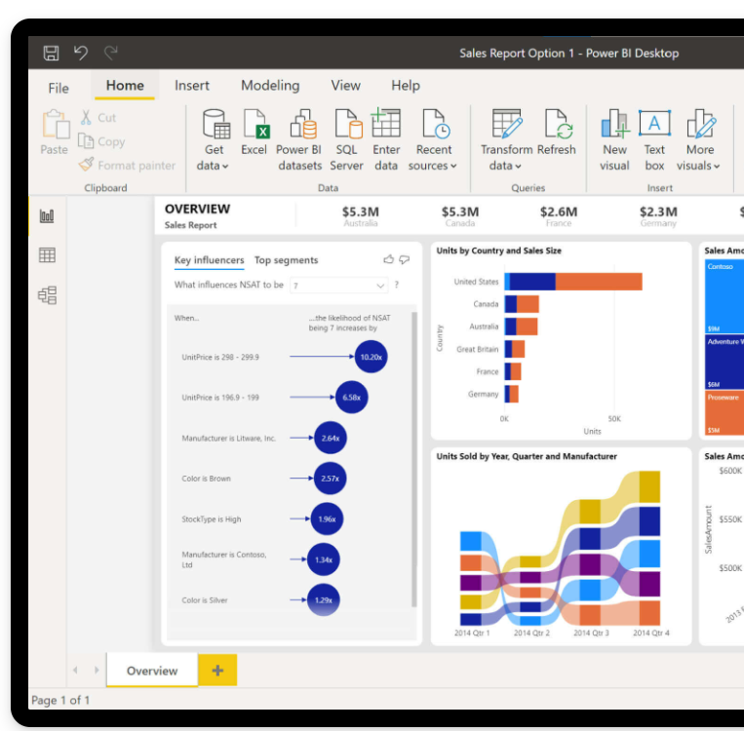
Introduction to Power BI free online training
POWER BI
BEGINNER
Preparation
DA-100 & PL-300
Monday 14th FEB
21:00 GMT

Slide 4
Power BI
Introduction to Power BI and your first Power BI report.
Recording on Youtube. Leave if not happy to be recorded
Each session sign up on Meetup.com for the live call
Each session will be a new Zoom link
Questions into the chat or raise your hand
All sessions available on YouTube
Microphones on mute….you are been recorded !!

Slide 5







David Moss
Azure | Power Platform | D365 Solutions Architect
Delivering end to end Azure, Power Platform, D365 BI hybrid solutions with a passion for Power Platform integration & Power BI reports across IoT, e-commerce, telcos, fintech, manufacturing & blockchain verticals.
MVP Data Platform
Since 2017 awarded MVP - Microsoft Valued Professional - for my community contributions.
Leader of Power BI meetup user groups online.
Community & conference presenter & MCT
ACMA, CGMA Accountant
@wottabyte
A qualified ACMA accountant all my career which keeps me commercially aware & business facing partner on projects.
wottabyte
www.wottabyte.com
Notes:
Hand out cards & stickers

Slide 6
Power BI
series of talks & presentations
in preparation for PL-300 (old DA-100)
Introduction to Power BI and your first Power BI report.
Use Power Query Editor to get data & prepare your data.
Use Power BI desktop to structure & create datamodels.
Design & configure Power BI visuals like charts, maps & KPIs.
Add user friendly report navigation features, slicers & tooltips.
Publish & share Power BI reports & dashboards.
Get to grips with Power BI cloud service & mobile features.
Enhance your data with DAX for KPIs reporting.
Data analytics reporting & AI features in Power BI.
Power BI at work with workspaces, datasets & security.

Slide 7
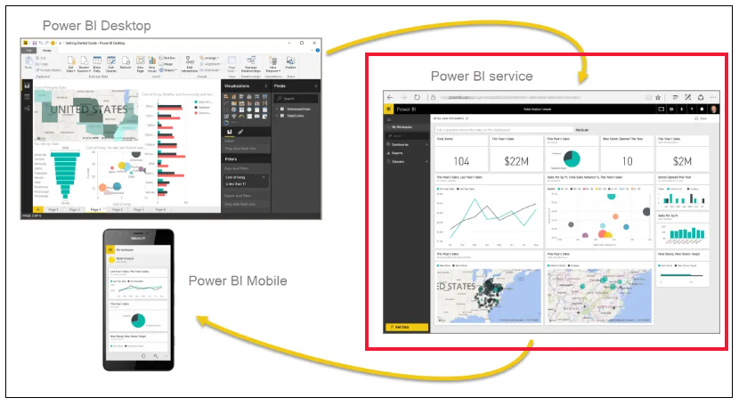
What is Power BI ?

Slide 8
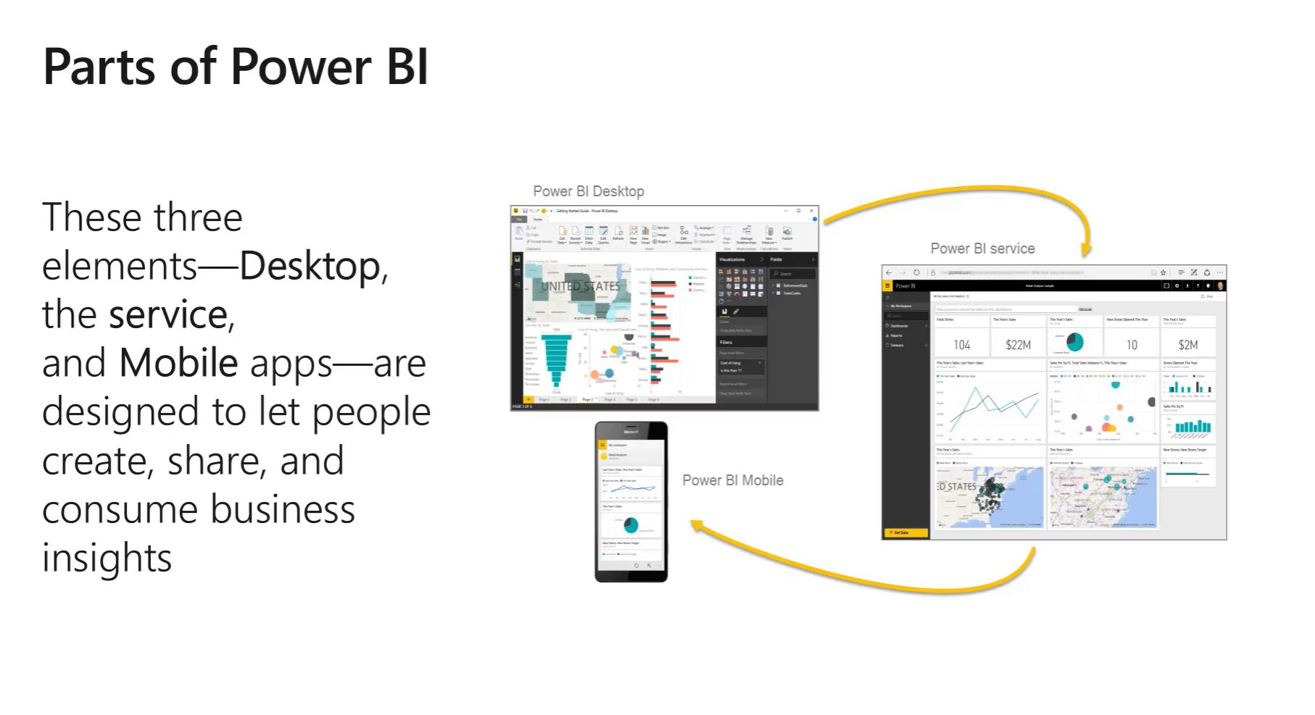
PBI Desktop, PBI Service, PBI Mobile apps
https://powerbi.microsoft.com/en-gb/

Slide 9
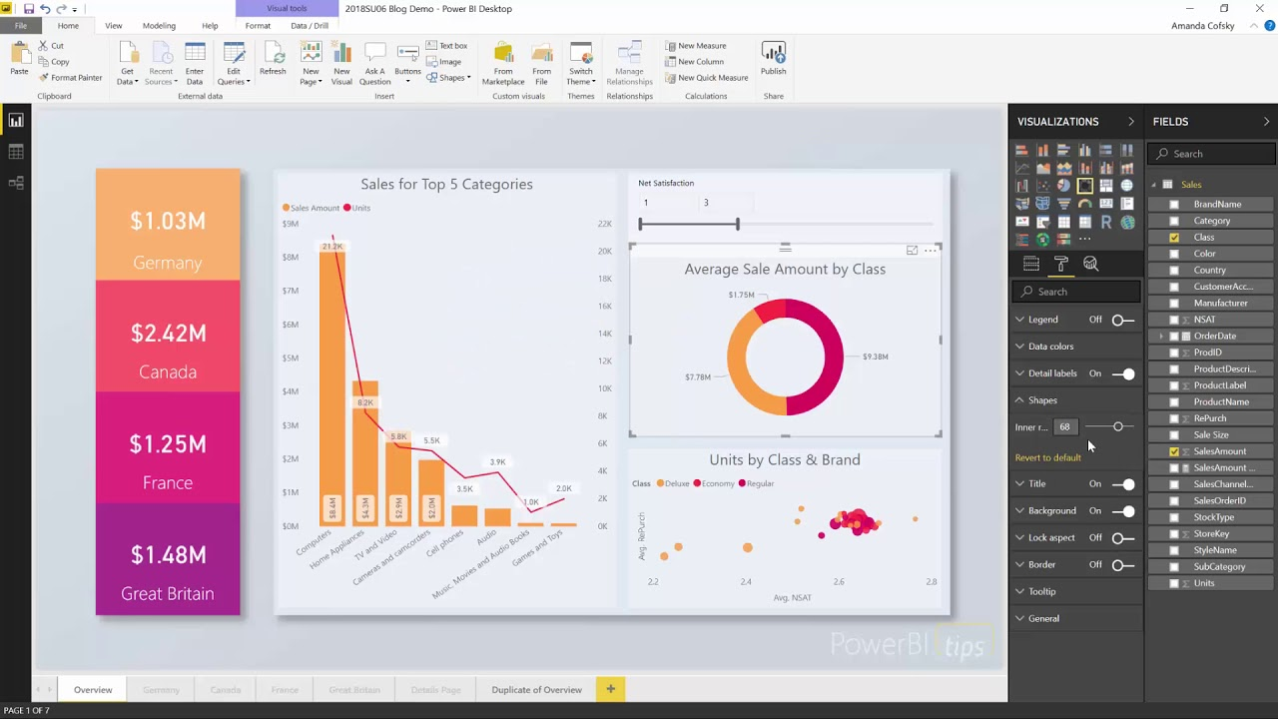
Notes:
Power BI Desktop … Installed ?

Slide 10
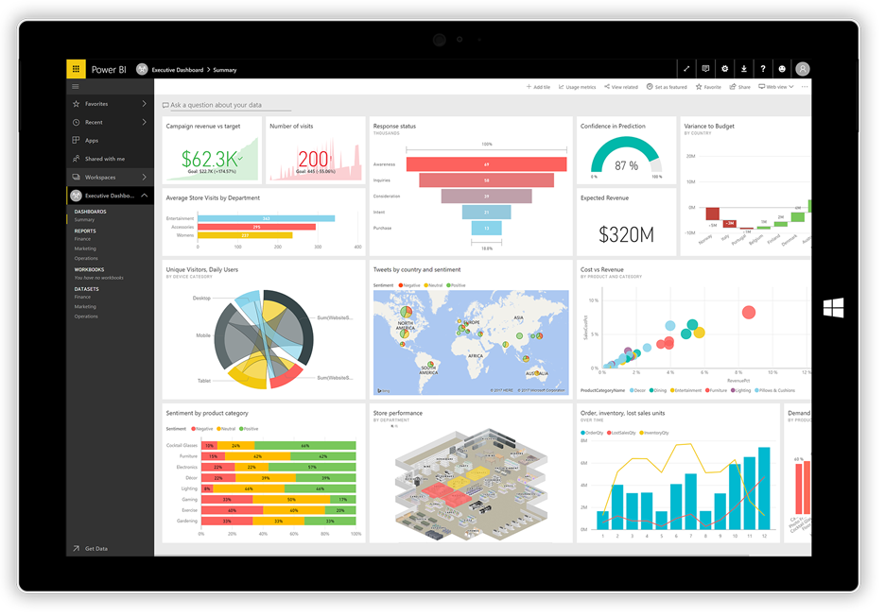
Notes:
Power BI Dashboard

Slide 11
Power BI Desktop
Download Power BI Desktop from https://powerbi.microsoft.com/
Install
Build your first report - use blog next page
Quick look at PBI Desktop features
Save your report as .pbix
Get a Microsoft account
Publish to Power BI Service app.powerbi.com

Slide 12
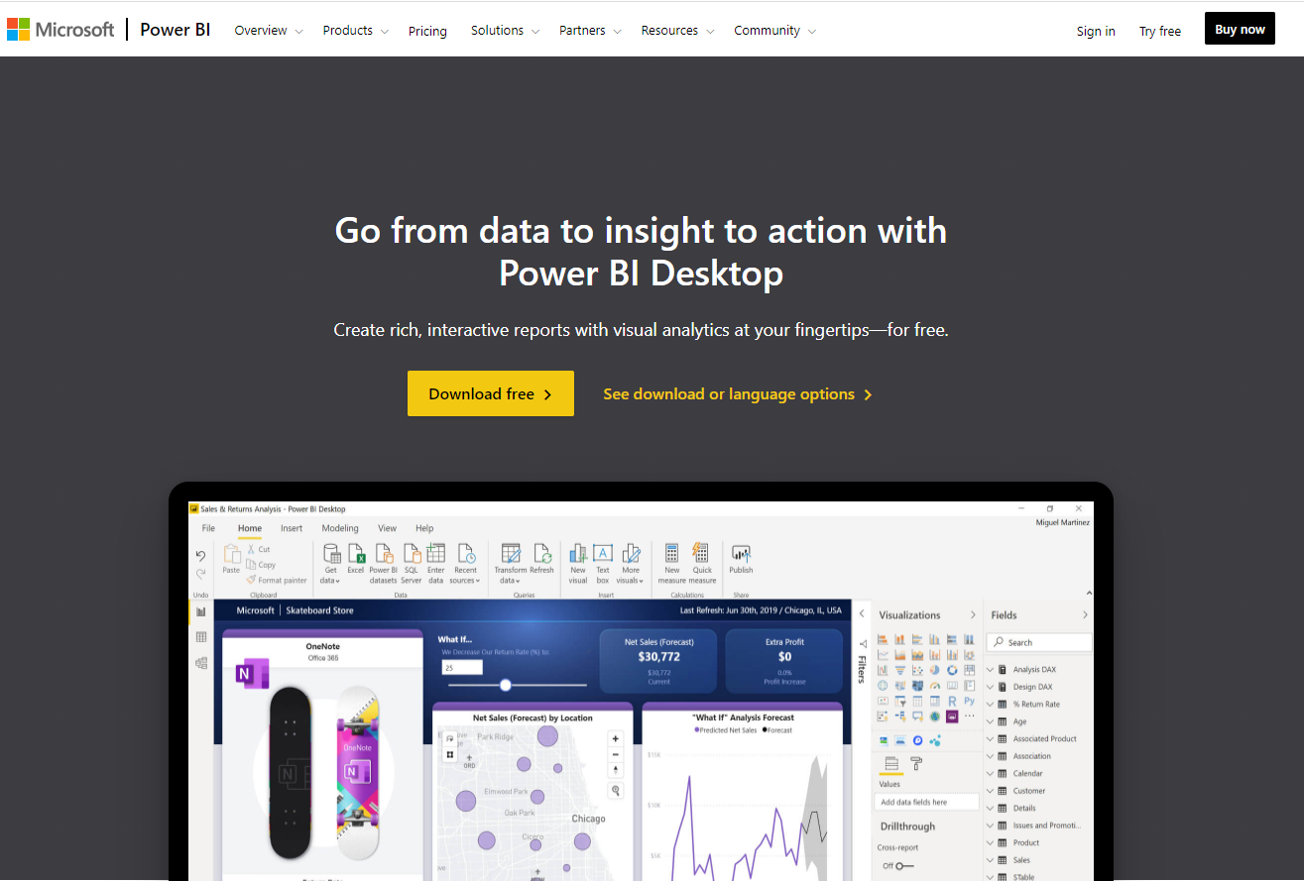
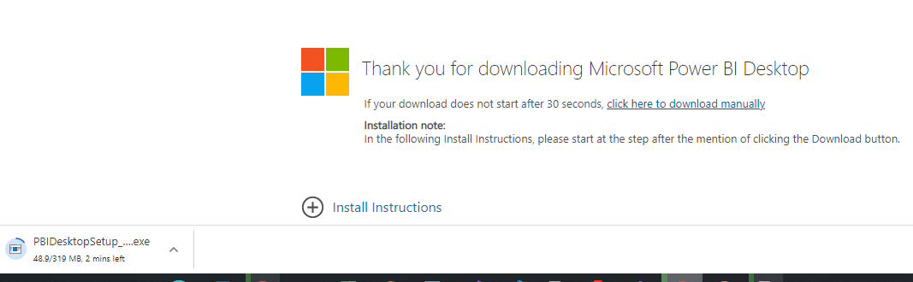
Power BI Desktop
Download Power BI Desktop
Windows Store - W10 app
Or Download desktop version
32 bit or 64 bit
Windows not Apple
What is PBI desktop ?
https://docs.microsoft.com/en-us/power-bi/fundamentals/desktop-getting-started
Desktop : https://powerbi.microsoft.com/en-us/desktop/
Store : https://aka.ms/pbidesktopstore

Slide 13
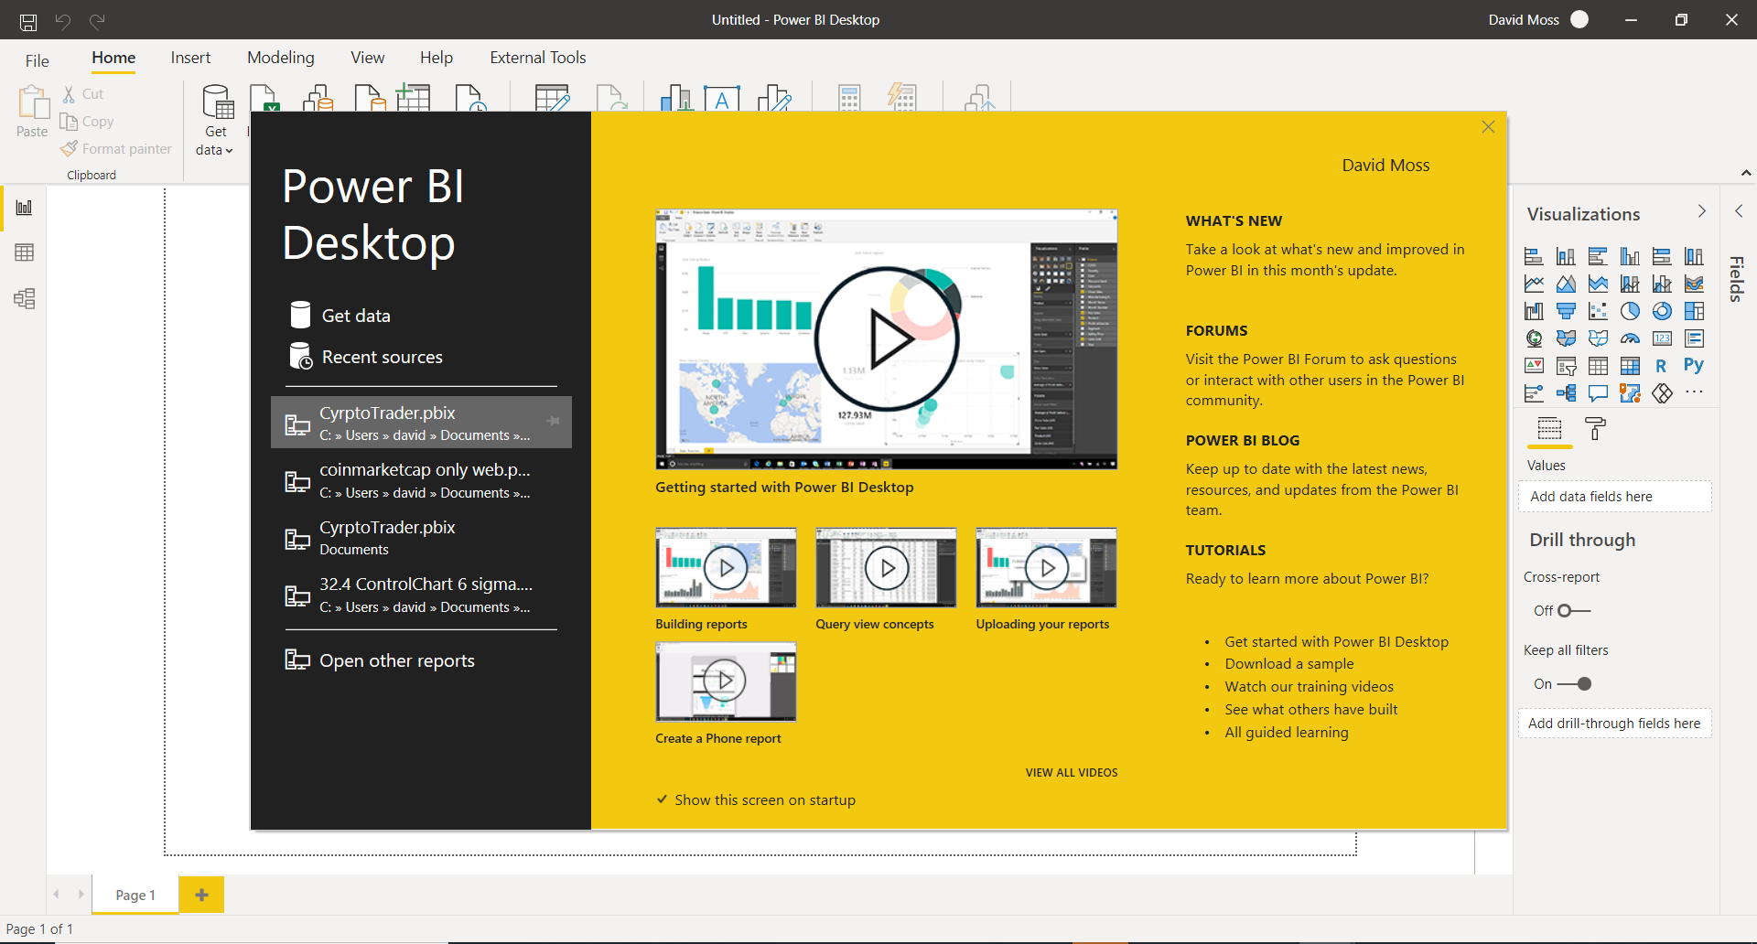

Slide 14
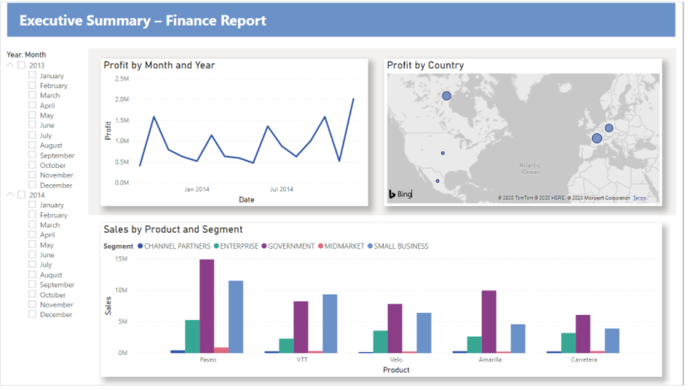
1 - build your first report
https://docs.microsoft.com/en-us/power-bi/create-reports/desktop-excel-stunning-report
More help: https://docs.microsoft.com/en-us/power-bi/fundamentals/desktop-getting-started
Notes:
Goto blog and walk through how to build this report.
|Blank .pbix file on main screen ‘ Try a sample Dataset’
Prepare date in PQE
Units Sold make whole number
Segment column use Transform>Format>UPPERCASE
Rename column ‘Month Name’ to Month
Product column remove ‘Montana’
Review Applied Steps
Close & Apply
Build report as per the blog

Slide 15
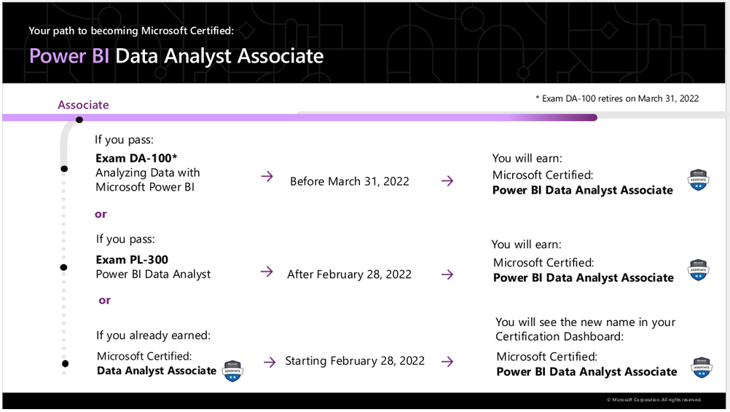
Microsoft Learn PL-300
Review curriculum
https://techcommunity.microsoft.com/t5/microsoft-learn-blog/announcing-a-new-name-for-the-data-analyst-associate/ba-p/2388941
https://docs.microsoft.com/en-us/learn/certifications/exams/da-100
https://docs.microsoft.com/en-us/learn/certifications/exams/pl-300

Slide 16
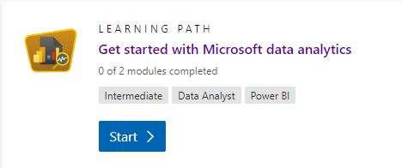
Preparation for next week
Microsoft Learn : https://docs.microsoft.com/en-us/learn/certifications/exams/da-100
Get started with MS data analytics https://docs.microsoft.com/en-us/learn/paths/data-analytics-microsoft/
Microsoft documentation : https://docs.microsoft.com/en-us/power-bi/learning-catalog/

Slide 17
Publish to www.powerbi.com
Sign in at www.powerbi.com
You need a MS a/c work account not a social email not gmail !!
https://docs.microsoft.com/en-us/power-bi/fundamentals/service-self-service-signup-for-power-bi

Slide 18
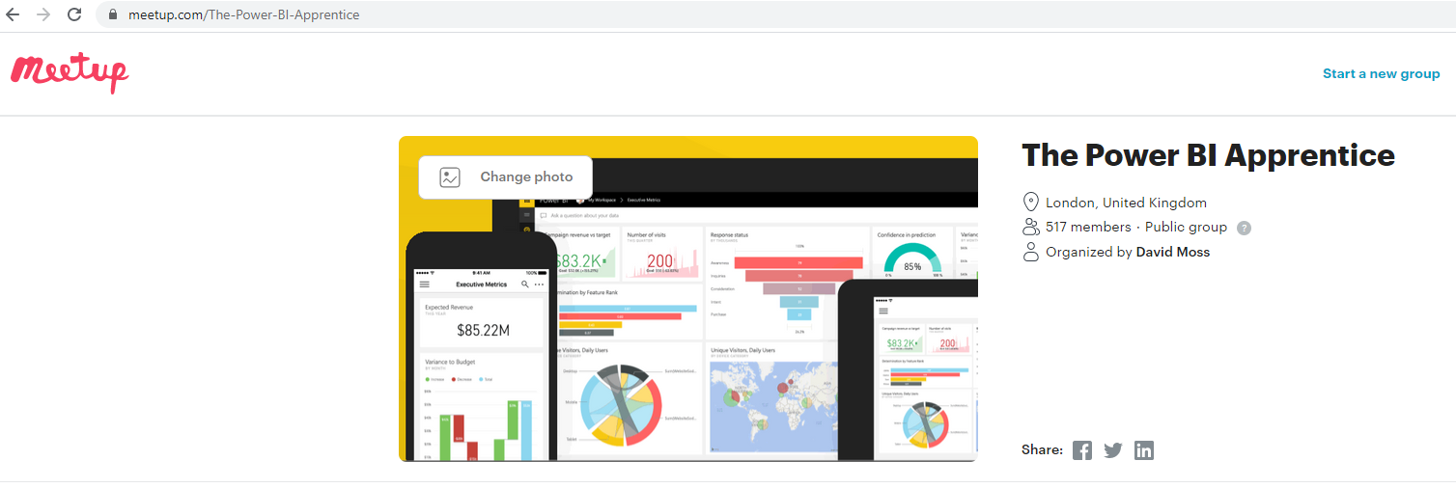
Social Media : Meetup , LinkedIN, YouTube

Slide 19
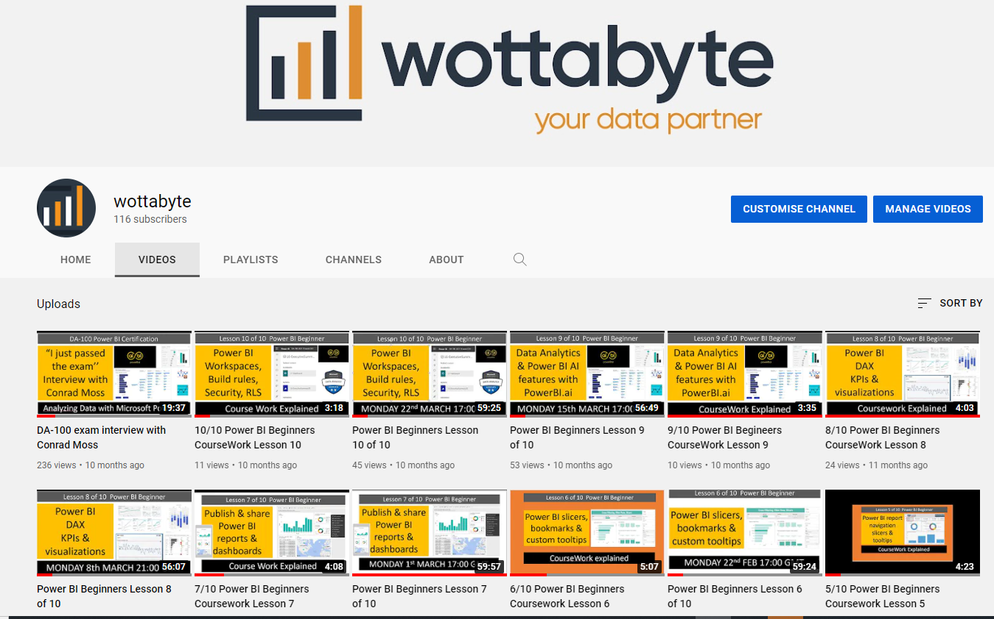
You Tube
https://www.youtube.com/channel/UCDtmmwK3YxWqzDNZ5L3pdMw

Slide 20
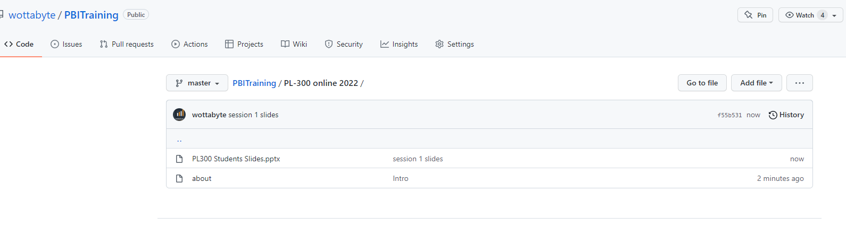
Github copy of Slides
https://github.com/wottabyte/PBITraining/tree/master/PL-300%20online%202022

Slide 21

The End

Slide 22
PL-300 Student’s Slides
Includes upto session 1

Slide 23
Lesson 2

Slide 24
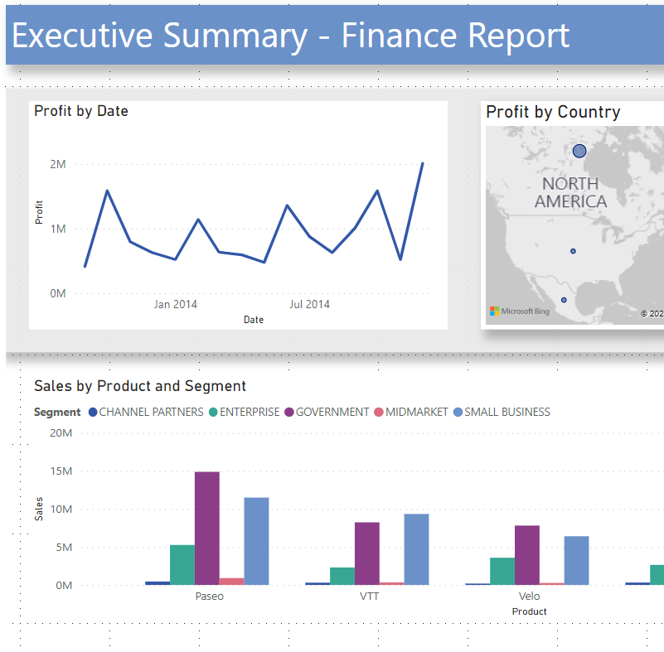
Introduction to Power BI free online training
2 - Build your 1st Power BI report.
DA-100 & PL-300
syllabus
Monday 21st FEB
20:00 GMT

Slide 25
Power BI
Introduction to Power BI and your first Power BI report.
Recording on Youtube. Leave if not happy to be recorded
Each session sign up on Meetup.com for the live call
Each session will be a new Zoom link
Questions into the chat or raise your hand
All sessions available on YouTube
Microphones on mute….you are been recorded !!

Slide 26
Power BI
series of talks & presentations
in preparation for PL-300 (old DA-100)
Introduction to Power BI and your first Power BI report.
PL-300 syllabus
Use Power Query Editor to get data & prepare your data.
Use Power BI desktop to structure & create datamodels.
Design & configure Power BI visuals like charts, maps & KPIs.
Add user friendly report navigation features, slicers & tooltips.
Publish & share Power BI reports & dashboards.
Get to grips with Power BI cloud service & mobile features.
Enhance your data with DAX for KPIs reporting.
Data analytics reporting & AI features in Power BI.
Power BI at work with workspaces, datasets & security.
https://powerbi.microsoft.com/en-gb/

Slide 27
1 - build your first report
https://docs.microsoft.com/en-us/power-bi/create-reports/desktop-excel-stunning-report
More help: https://docs.microsoft.com/en-us/power-bi/fundamentals/desktop-getting-started
Notes:
Goto blog and walk through how to build this report.
|Blank .pbix file on main screen ‘ Try a sample Dataset’
Prepare date in PQE
Units Sold make whole number
Segment column use Transform>Format>UPPERCASE
Rename column ‘Month Name’ to Month
Product column remove ‘Montana’
Review Applied Steps
Close & Apply
Build report as per the blog

Slide 28
Tidy up report
Last week we ingested the data in the Power Query Editor
We made some simple transformations
We started to build the report
Lets continue in Power BI Desktop and build 1st report.

Slide 29
Microsoft Learn PL-300
Review curriculum
https://techcommunity.microsoft.com/t5/microsoft-learn-blog/announcing-a-new-name-for-the-data-analyst-associate/ba-p/2388941
https://docs.microsoft.com/en-us/learn/certifications/exams/da-100
https://docs.microsoft.com/en-us/learn/certifications/exams/pl-300

Slide 30
PL-300 syllabus
See the excel sheet with the breakdown of the PL-300 syllabus

Slide 31
Preparation for next week
Microsoft Learn : https://docs.microsoft.com/en-us/learn/certifications/exams/da-100
Get started with MS data analytics https://docs.microsoft.com/en-us/learn/paths/data-analytics-microsoft/
Microsoft documentation : https://docs.microsoft.com/en-us/power-bi/learning-catalog/

Slide 32
Social Media : Meetup , LinkedIN, YouTube

Slide 33
You Tube
https://www.youtube.com/channel/UCDtmmwK3YxWqzDNZ5L3pdMw

Slide 34
Github copy of Slides
https://github.com/wottabyte/PBITraining/tree/master/PL-300%20online%202022

Slide 35
Publish to www.powerbi.com
Sign in at www.powerbi.com
You need a MS a/c work account not a social email not gmail !!
https://docs.microsoft.com/en-us/power-bi/fundamentals/service-self-service-signup-for-power-bi

Slide 36
Lesson 3

